Slide 1
OCR for text detection and recognition
Test on drug packages from Google images

Slide 2
Crawled images from drug list
ABIES NIG.
ACETAMINOPHEN
ACONITUM NAP.
ACONITUM NAPELLUS
ACYCLOVIR
ADAPALENE BENZOYL PEROXIDE
ADRENALINUM
ALBUTEROL SULFATE
ALLIUM SATIVUM
ALUMINUM CHLORIDE
AMIKACIN SULFATE
AMITRIPTYLINE HYDROCHLORIDE
AMMONIA INHALANTS

Slide 3
Data preprocessing
Exclude drug unrelated images
Remove samples with text less than 10 chars
Remove samples has text more than 200 chars
Finally 104 images left

Slide 4
Similarity matrix based on English
Pair of images
 | 0 | 1 | 2 | 3 | 4 | 5 | 6 | 7 | 8 | 9 | 10
0 | 100 | 87 | 30 | 55 | 34 | 22 | 27 | 24 | 23 | 22 | 28
1 | 87 | 100 | 25 | 61 | 37 | 23 | 27 | 23 | 22 | 22 | 20
2 | 30 | 25 | 100 | 26 | 17 | 33 | 17 | 36 | 23 | 33 | 26
3 | 55 | 61 | 26 | 100 | 31 | 19 | 21 | 18 | 21 | 33 | 18
4 | 34 | 37 | 17 | 31 | 100 | 26 | 21 | 20 | 23 | 17 | 20
5 | 22 | 23 | 33 | 19 | 26 | 100 | 24 | 22 | 13 | 28 | 21
6 | 27 | 27 | 17 | 21 | 21 | 24 | 100 | 34 | 26 | 33 | 18
7 | 24 | 23 | 36 | 18 | 20 | 22 | 34 | 100 | 26 | 39 | 17
8 | 23 | 22 | 23 | 21 | 23 | 13 | 26 | 26 | 100 | 22 | 36
9 | 22 | 22 | 33 | 33 | 17 | 28 | 33 | 39 | 22 | 100 | 33
10 | 28 | 20 | 26 | 18 | 20 | 21 | 18 | 17 | 36 | 33 | 100
103
103

Slide 5
Top 5 similarity score for every row
 | Top 1 | Top 2 | Top 3 | Top 4 | Top 5
0 | 87 | 55 | 47 | 38 | 38
1 | 87 | 61 | 47 | 38 | 38
2 | 42 | 36 | 35 | 33 | 33
3 | 61 | 55 | 42 | 36 | 36
4 | 44 | 43 | 40 | 40 | 40
5 | 46 | 38 | 36 | 33 | 32
6 | 37 | 34 | 33 | 32 | 31
7 | 46 | 39 | 38 | 38 | 36
8 | 36 | 33 | 32 | 32 | 31
9 | 50 | 44 | 40 | 39 | 39
10 | 83 | 62 | 36 | 36 | 33
11 | 66 | 42 | 36 | 35 | 35
12 | 39 | 35 | 35 | 34 | 32
13 | 32 | 32 | 31 | 31 | 29
14 | 90 | 37 | 34 | 33 | 32
15 | 32 | 31 | 31 | 31 | 30
16 | 74 | 44 | 40 | 34 | 33
17 | 44 | 36 | 36 | 36 | 32
18 | 44 | 39 | 35 | 32 | 32
19 | 74 | 47 | 47 | 47 | 47
103

Slide 6
Classification of top 5 results
For each images, get similarity scores with all other images
Rank and get top 5 results has highest similarity score for each image
If all top_5 has the same label, accuracy is 100%
If 4 of top_5 has the same label, accuracy is 80%

Slide 7
Accuracy of top 5 score results
Details are displayed in following slides

Slide 8
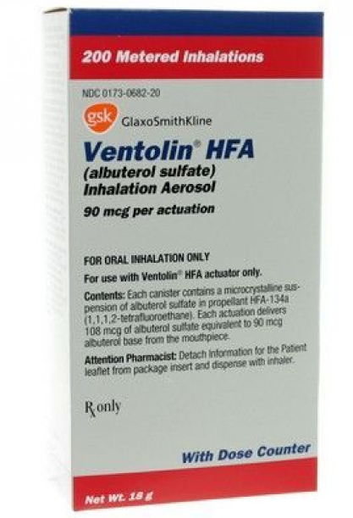
Selected Image result with high accuracy
images with highest similarity

Slide 9
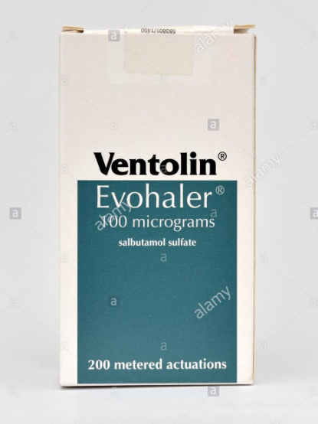
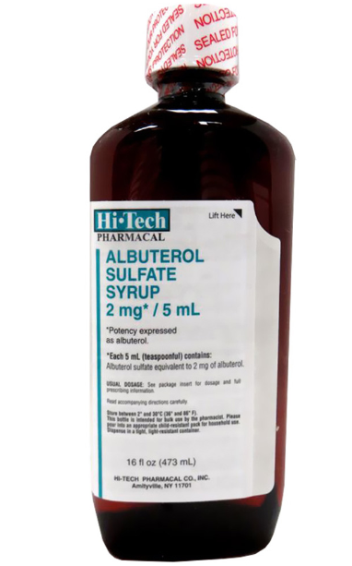
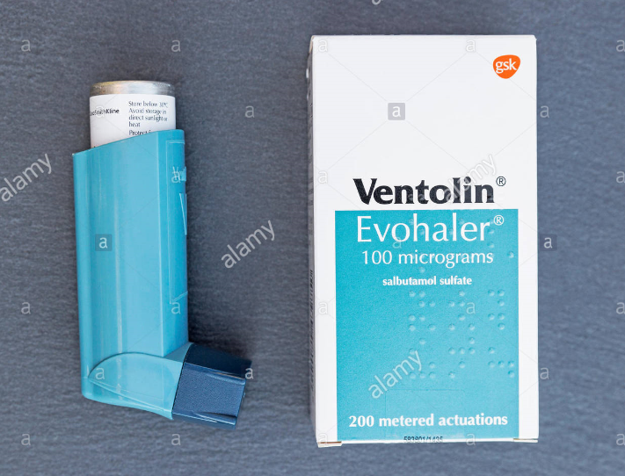
Similarity Score
Similarity Score
Similarity Score
46 39 38
Similarity Score

Slide 10
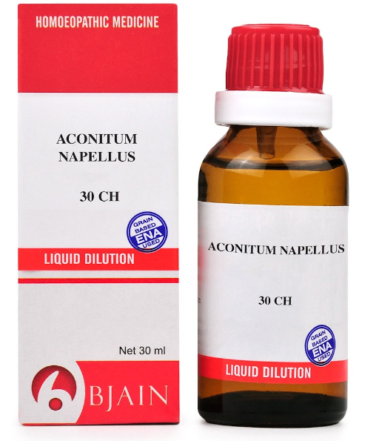
Selected Image result with high accuracy
images with highest similarity

Slide 11
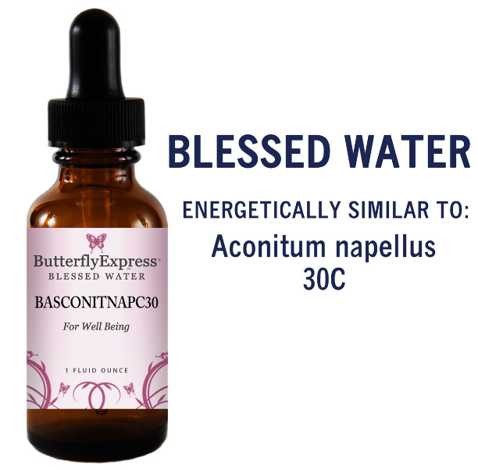
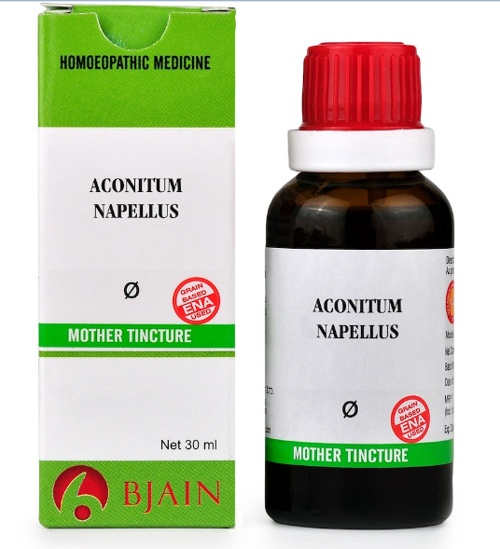
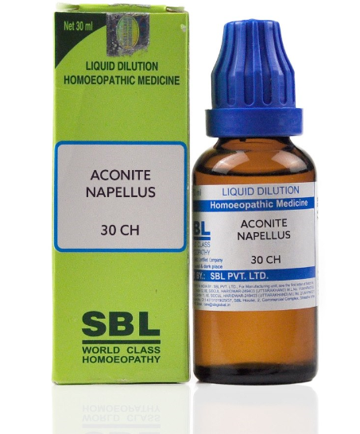
Similarity Score
Similarity Score
Similarity Score
87 53 39

Slide 12
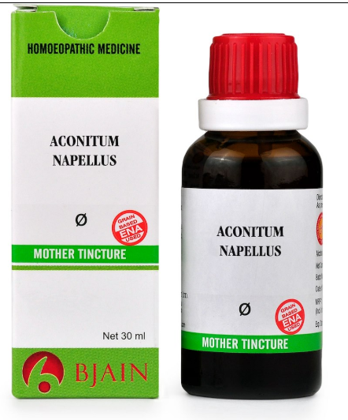
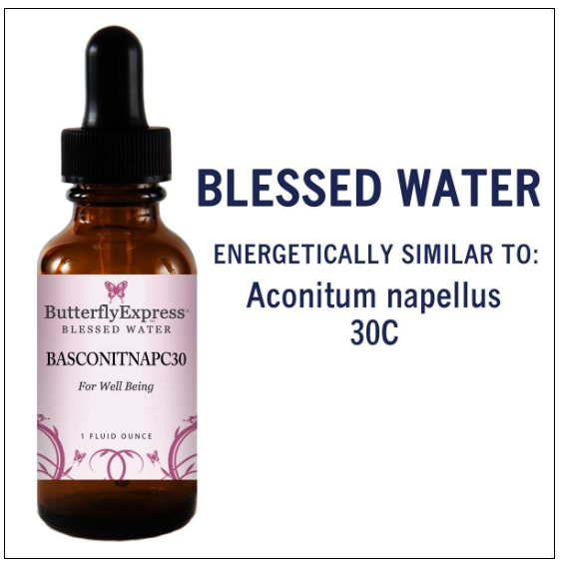
Similarity Score
73 46
Similarity Score

Slide 13
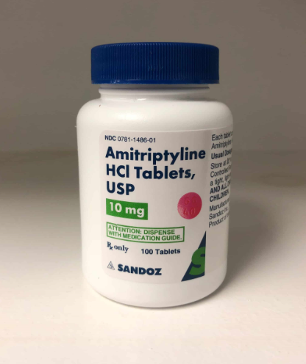
Selected Image result with high accuracy
images with highest similarity

Slide 14
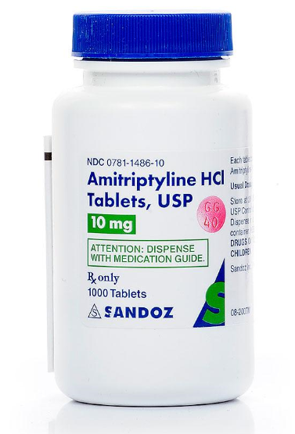
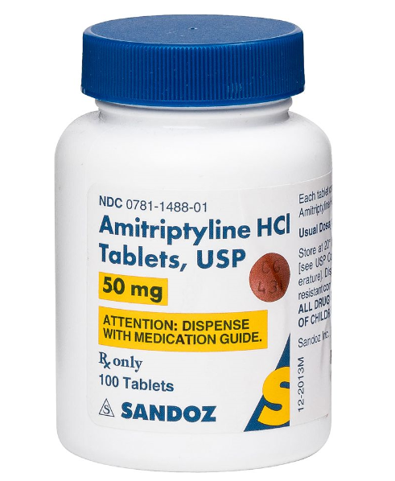
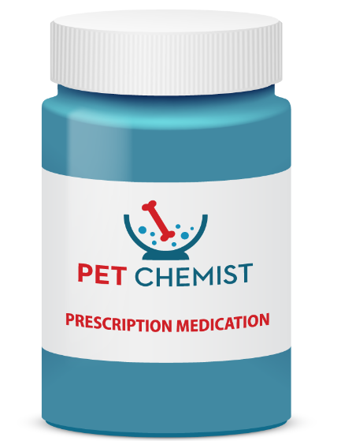
Similarity Score
Similarity Score
Similarity Score
68 53 49

Slide 15
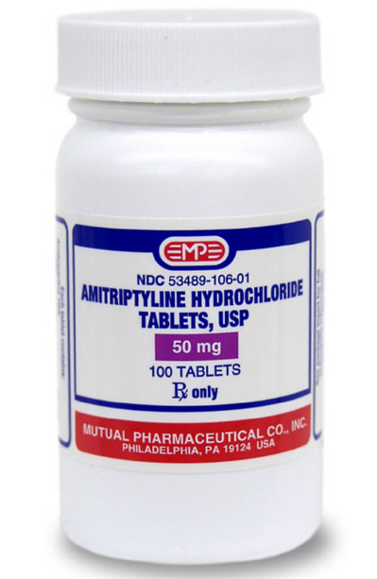
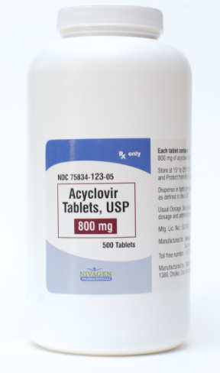
Similarity Score
44 37
Similarity Score

Slide 16
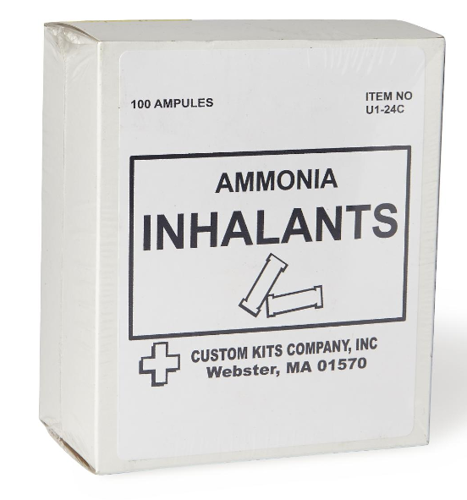
Image result with 0 accuracy
images with highest similarity

Slide 17
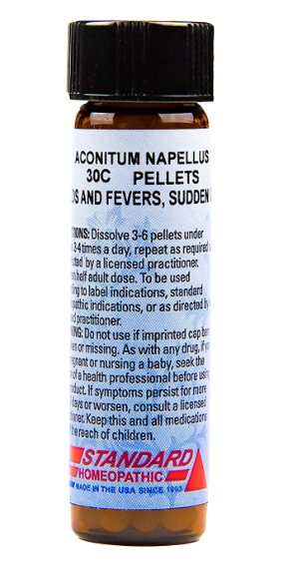
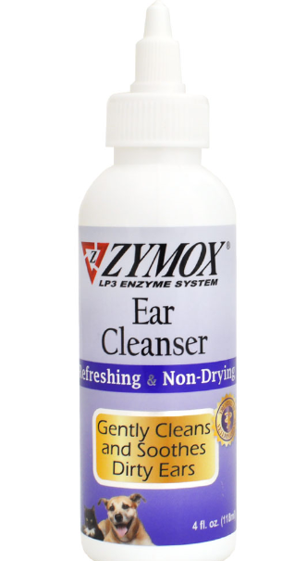
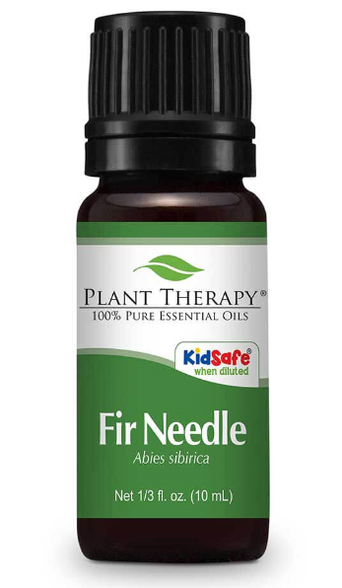
Similarity Score
Similarity Score
Similarity Score
42 36 35

Slide 18
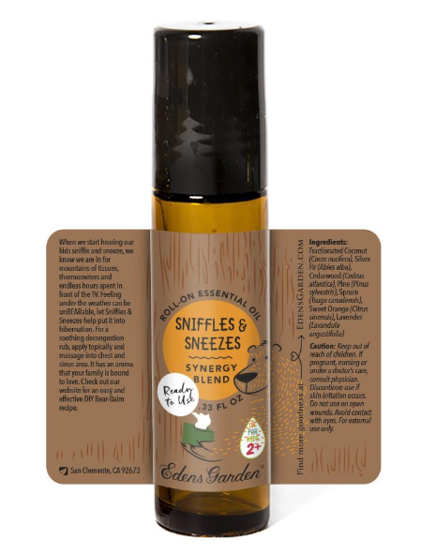
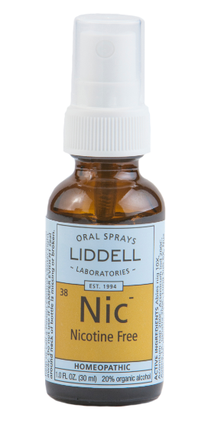
Similarity Score
33 33
Similarity Score

Slide 19
Average similarity score difference
Average score over all 104 scores for each row as A1
Average score over top 5 scores for each row as A2
Score difference is D = A2 – A1
Following is bar char for D over all images

Slide 20
Select images through high score differences

Slide 21
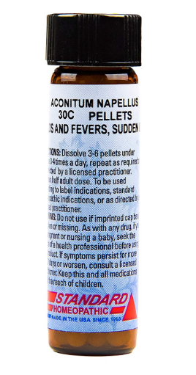
Selected Image result with high score differences
Top 5 average Score: 73.2 Total average Score: 28.1
5 images with highest similarity

Slide 22
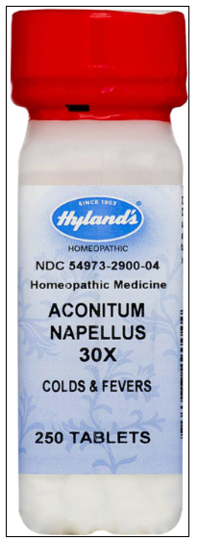
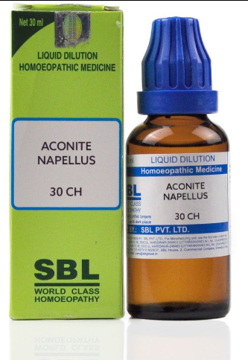
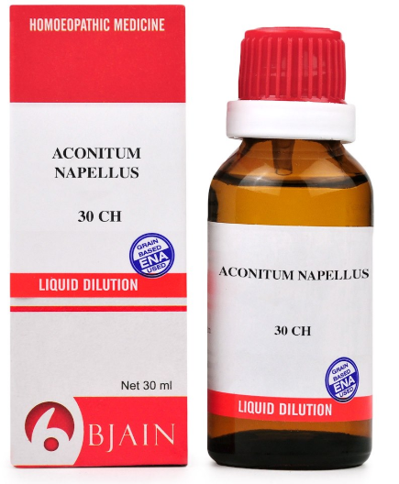
85 85 77

Slide 23
73 46

Slide 24
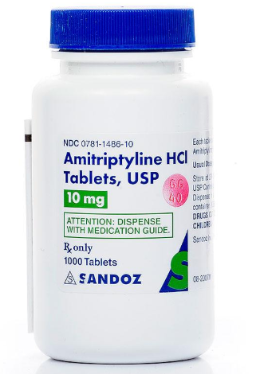
Selected Image result with high score differences
Top 5 average Score: 55 Total average Score: 24.4
5 images with highest similarity

Slide 25
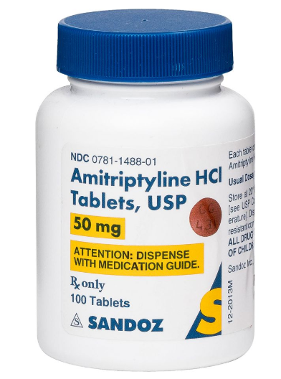
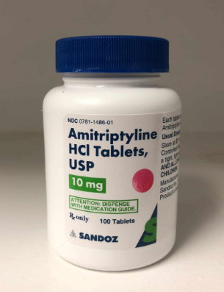
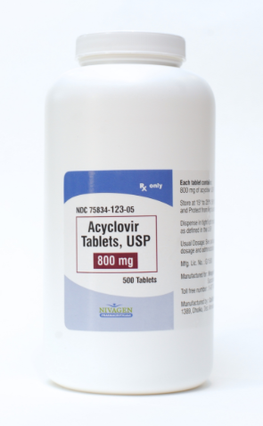
68 64 63

Slide 26
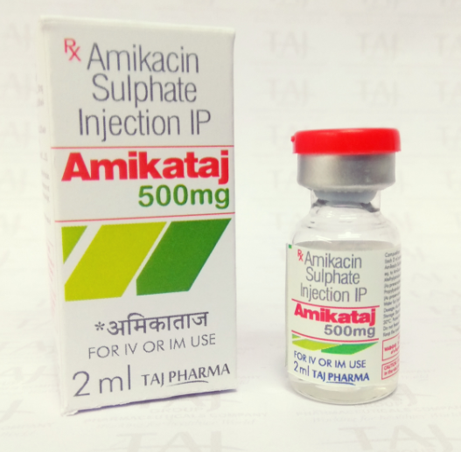
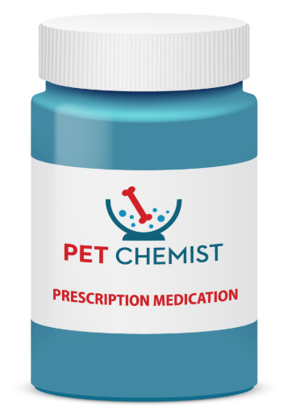
42 41

Slide 27
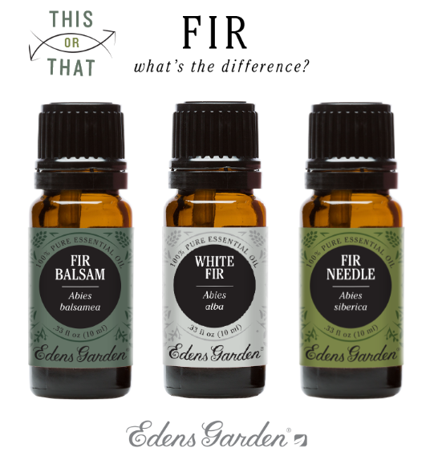
Selected Image result with low score differences
Top 5 average Score: 33.4 Total average Score: 23.9
5 images with highest similarity

Slide 28
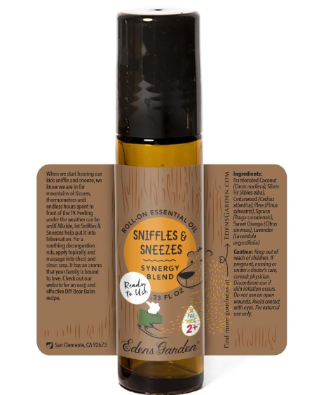
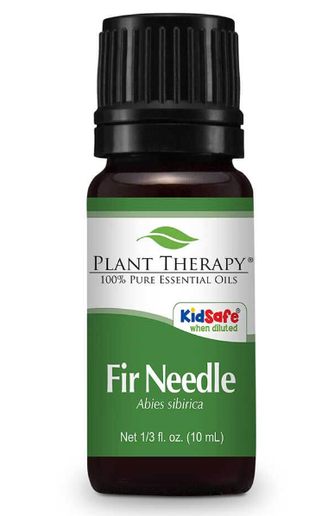
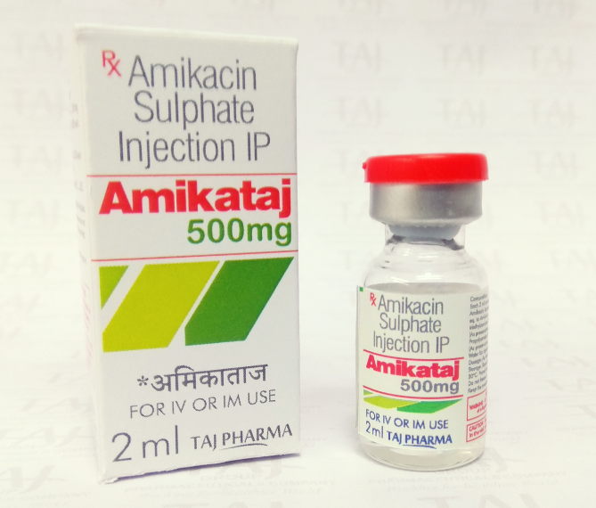
37 34 33

Slide 29
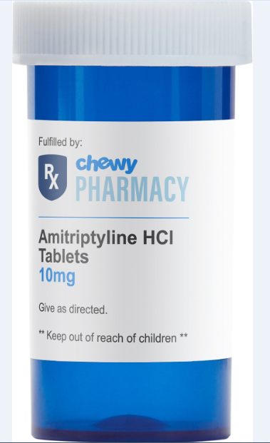
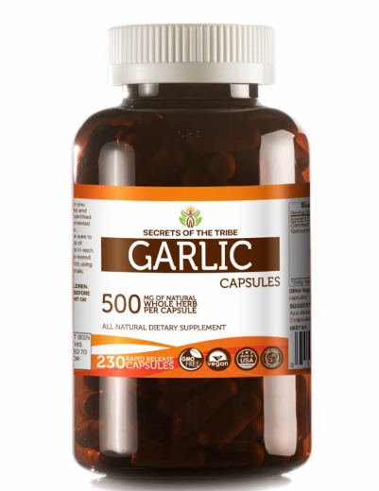
32 31

